Slide 1

MovieDiscuss Project check-in
By Team O’Brien - Nikita Khavronin, Aryan Chandra, Stephanie Ndulue

Slide 2
Presentation Outline
Project Background
Project activity status: Green
Business Case
Project Scope Statement
Project Roles and Responsibilites
Project Charter
Kanban Board
Low fidelity prototype
User Questionnaire
UML Process Diagram
UML Data Diagram
Code in progress
What’s left to do?

Slide 3

Project Background
To: Create a community for movie watchers online
By: Developing a website where people can view recommendations, rate movies, and discuss about movies of interest in real time via chat rooms

Slide 4
Project activity status: Green
what are we proud of or what is the secret to our success?
We have been able to keep to schedule and complete all our project deliverables on time.
This is done by planning weekly meetings, assigning tasks deliverables according to roles in the team, staying in constant contact outside meetings and deligently completing assigned tasks

Slide 5
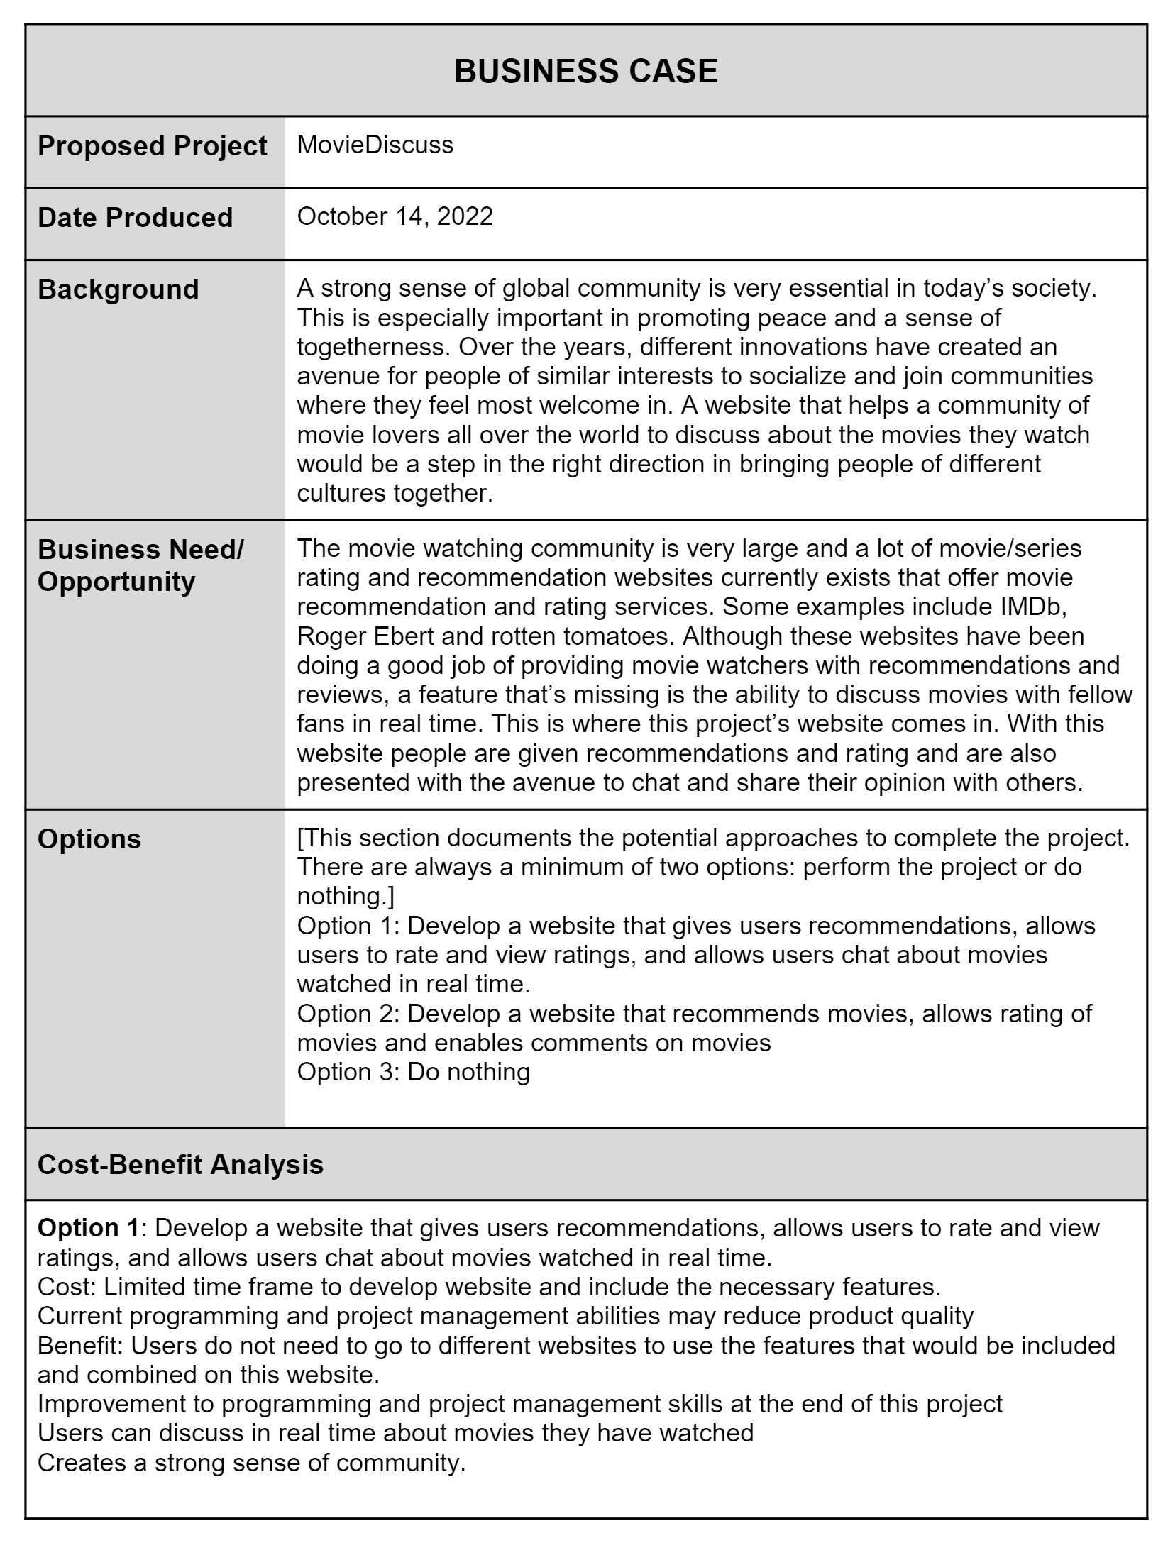
Business Case

Slide 6
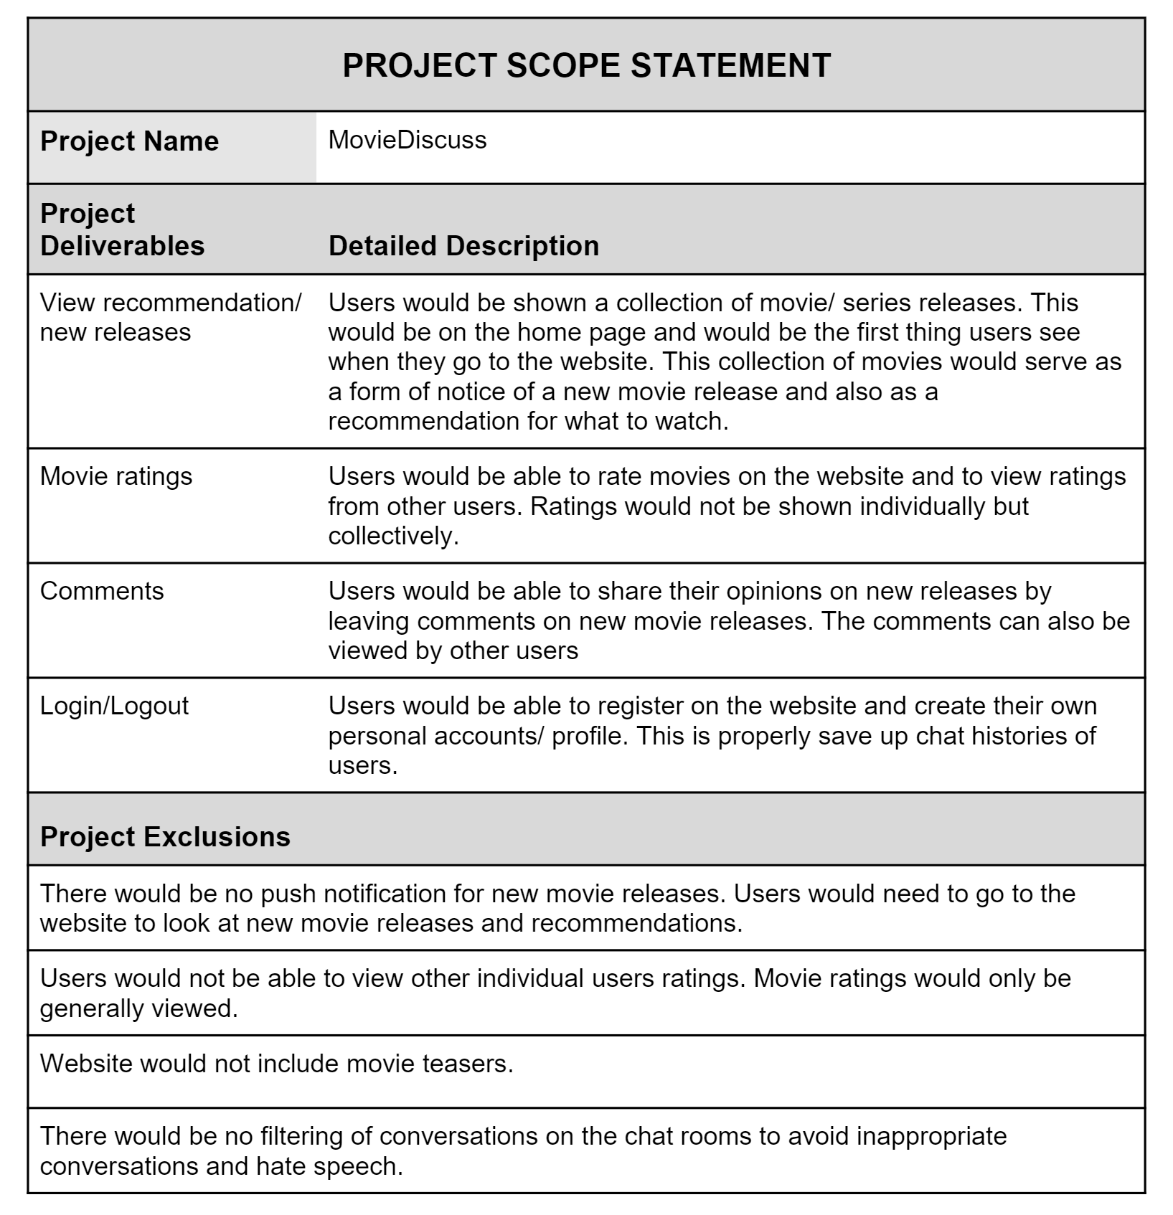
Project Scope Statement

Slide 7
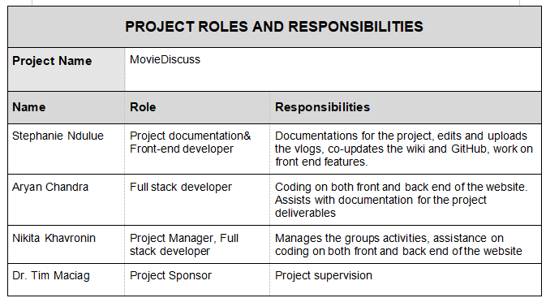
Project Roles and Responsibilites

Slide 8
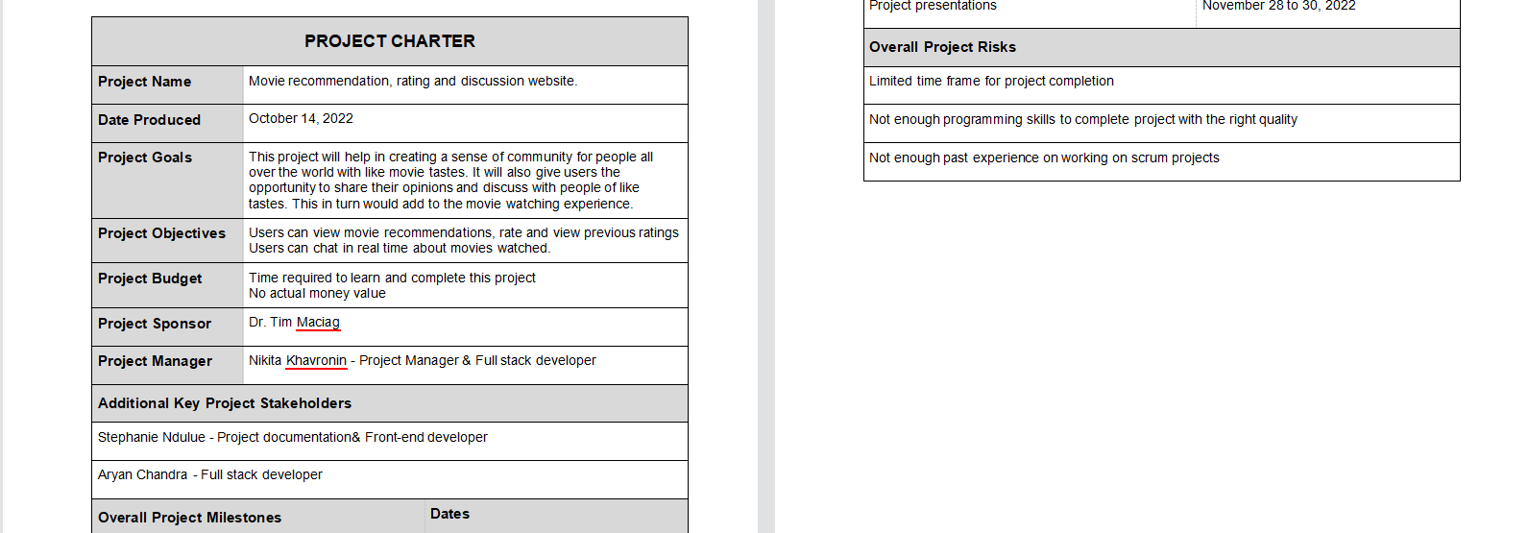
Project Charter

Slide 9
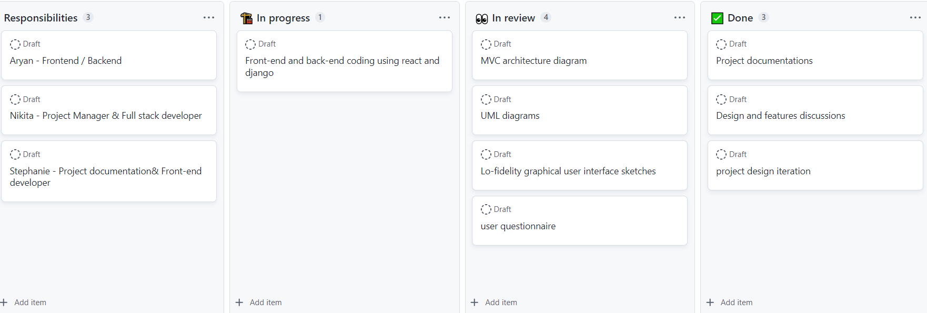
Kanban board

Slide 10
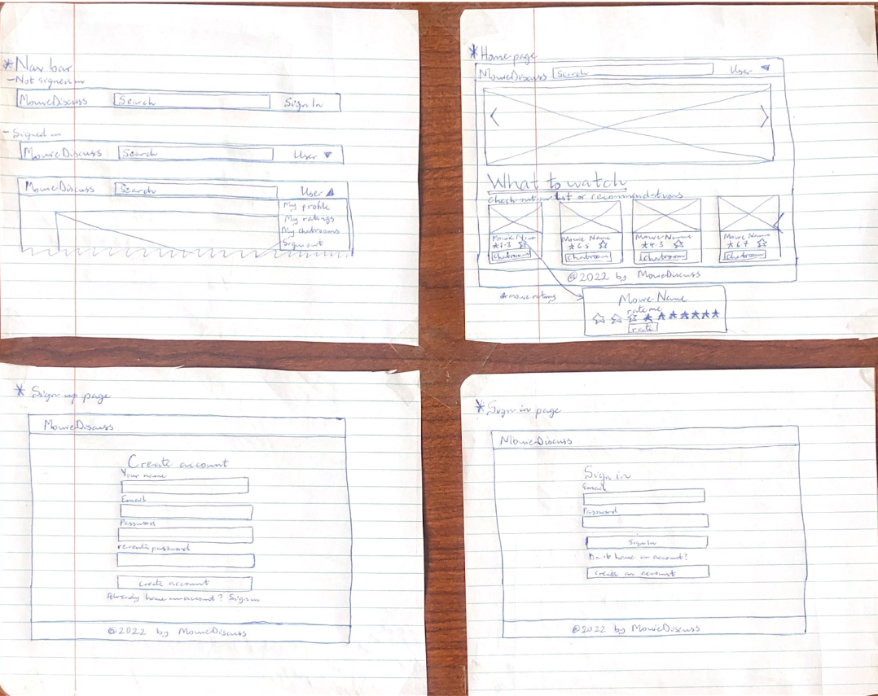
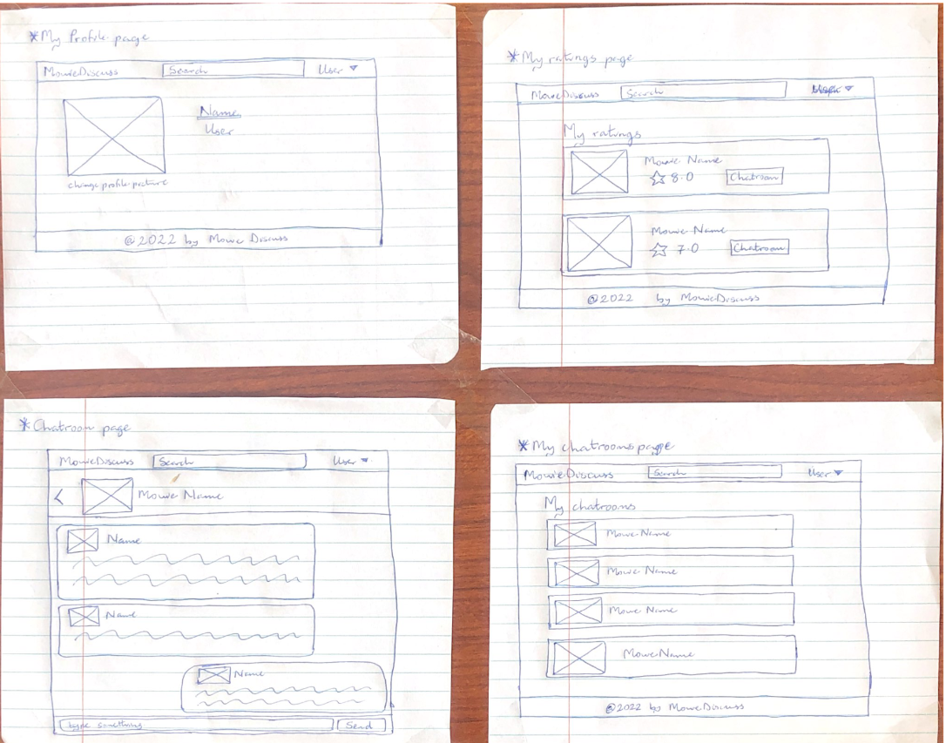
Low Fidelity prototype

Slide 11
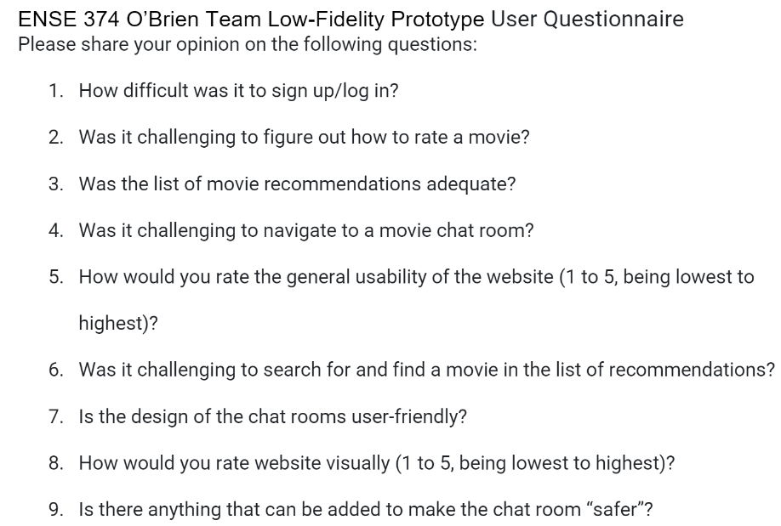
User Questionnaire

Slide 12
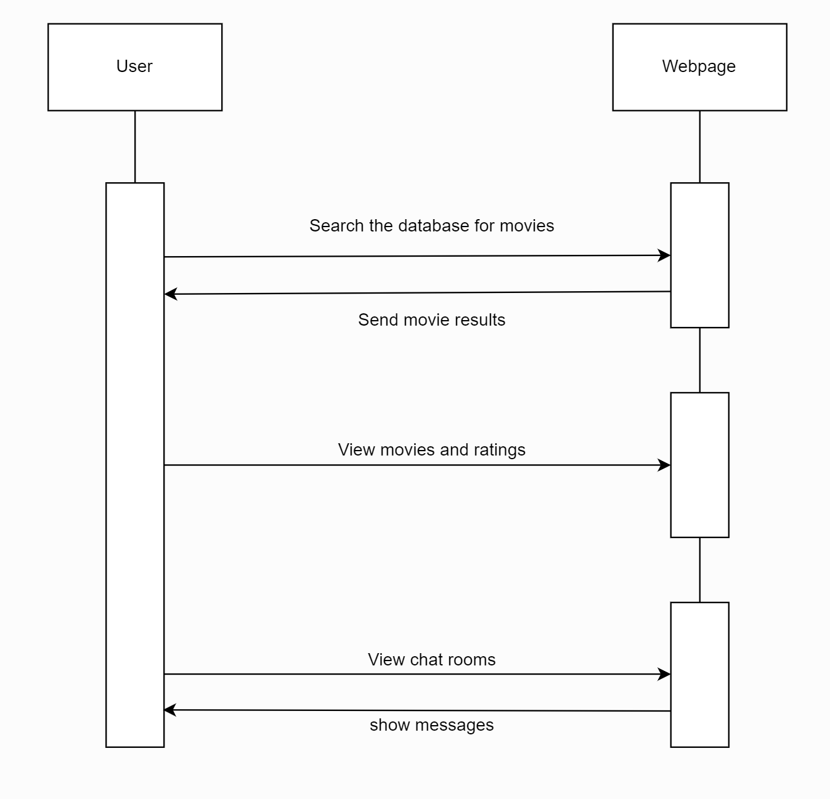
UML Process Diagram

Slide 13
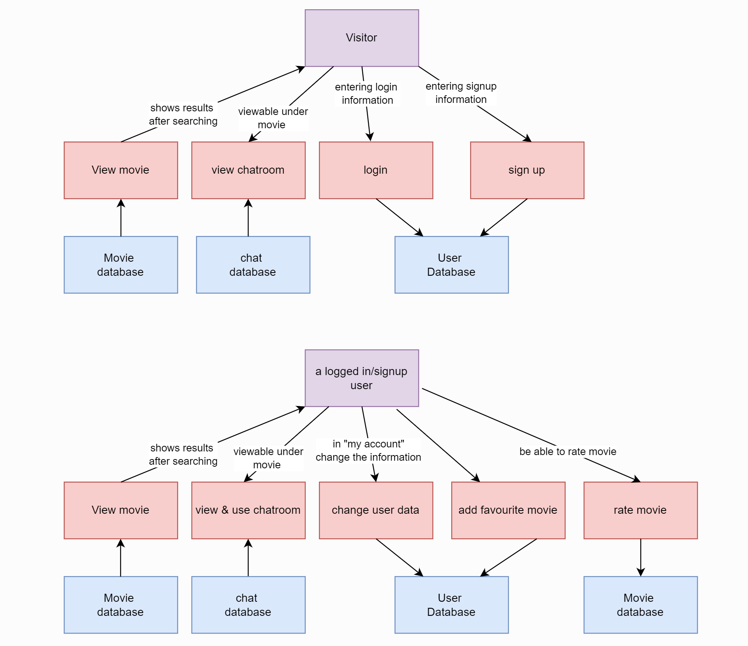
UML Data Diagram

Slide 14

Code in progress

Slide 15
What's left to do?
Completion of the integration of feedback to project
Development completion and testing of website

Slide 16

Thank you

